Slide 1
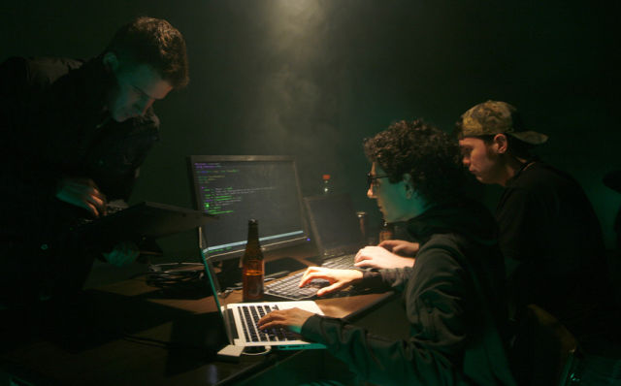


Board Introduction
President - Tyler Chong
VP - Sean Takafuji
Secretary - Trevin Tejero
Treasurer - Kirsten Takanishi

Slide 2

Our Objective
Our main purpose is to develop and encourage cyber security awareness and application by providing students with the tools and education they need to advance their cyber security careers.
Host Tech Talks and Guest Speakers
Participate in security related competitions and conventions
Train future Script Kiddies (Skiddies) in the use of hacking tools
Notes:
Basically educate people about Cyber Security & and get you job ready
Tech Talks - A tutorial about a tool

Slide 3

Communication
Slack
greyhatsuhm.slack.com/signup
Ask us for an invite
Bi-weekly emails
Notes:
Slack is our main source of communication (we do send out biweekly emails, but those are more random)
#events Channel is where events are posted
#general Announcements
#random memes
If you don’t have a hawaii.edu email, let me know and I can invite you.

Slide 4
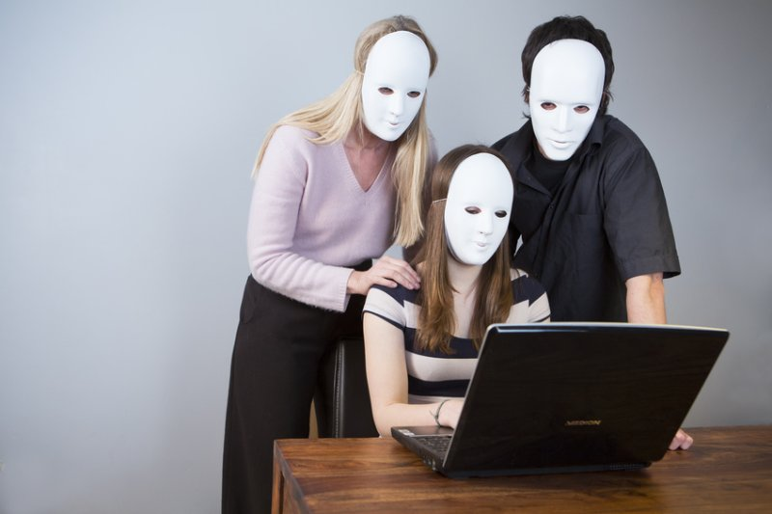
Frequently Asked Questions
What do i need?
A can-do attitude
Liability waiver
What should I learn?
Check out the github for examples
Everything
Notes:
You are going to need to sign a liability waiver. Basically says we are not accountable for things you do with the tools you learn in this club.
Everything - Cyber Security has a ton of sub fields
Introduce speaker

Slide 5
What is Cyber Security?
Protecting Information
Money
Personal Identification
Government
Defending and Attacking
Thinking on both sides
Scouting, Research, Exploiting
Notes:
Protecting Information
Grey Hats - Defending and Attacking

Slide 6
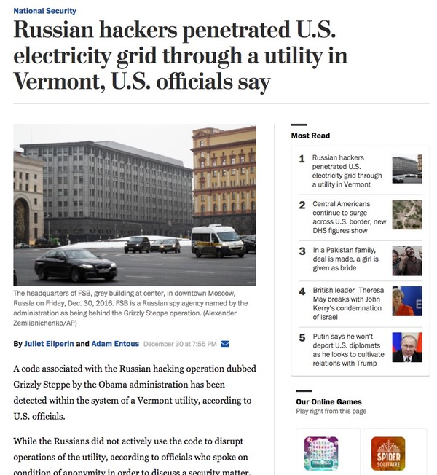

Why is Cyber Security important?
Notes:
Equifax, one of the three major consumer credit reporting agencies, said on Thursday that hackers had gained access to company data that potentially compromised sensitive information for 143 million American consumers, including Social Security numbers and driver’s license numbers

Slide 7
Our Goals
Learn Outside Of The Classroom
Participate In Events
Win Competitions/Try our best
Notes:
Apply ourselves to learn more than we have to
Show that we are well rounded people who are social
Show our skills through winning competitions

Slide 8
Why You Should Compete
Set yourself apart
Acquire new skills
Notes:
Everyone goes to classes, but not everyone takes the time to do extra. (Step out of your comfort zone)
This shows that you are committed to learning your field, and that you have initiative
And if you win, it shows how skilled you are in that field. And whatever prizes you get
Often times, competitions will have challenges that you don’t know how to do.
This is good because it actually forces you to learn new material, instead of doing the same old thing over and over again.
Next Slide - List of Competitions

Slide 9
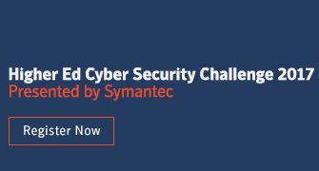



Competitions
Cyber Security Awareness Week (CSAW CTF) [September 15-17]
Student-Run Cyber Security Event
D-CTF 2017 Quals 2017 [September 30 Qualification Round]
National Cyber League (NCL) [Nov. 3 - 5]
Seasonal CTF Challenge
Check out the #events channel on Slack!
Notes:
All events will be posted in the #events Slack channel

Slide 10

Cyber Security Awareness Week Qualifiers (CSAW CTF)
September 16
Keller 105
Meet Up
Notes:
4-5/10 on the difficulty scale
Meetup in Keller 105

Slide 11
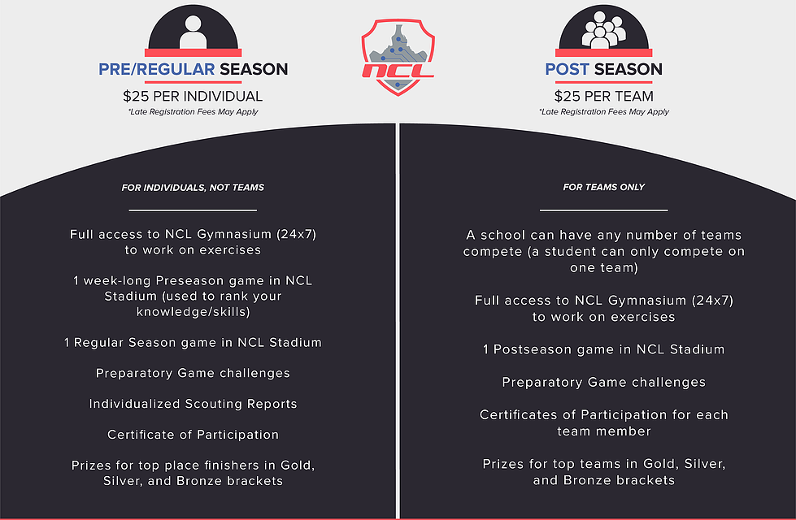
National Cyber League
Live Registration
https://www.nationalcyberleague.org/
Notes:
National Cyber League is going to be an event we do
Probably have a meetup day for it too

Slide 12
What do I need to know?
Operating Systems
Command Line
Programming Languages (Python, JavaScript/PHP, C, Assembly)
Critical Thinking (Unique perspective)
Networking (Routers, Switches, TCP/IP)
Encryption (Cryptography)
Base64
MD5
Hashes
Even if you don’t know any of this, you will learn it
Notes:
Sink or swim

Slide 13
Types of Attacks
Phishing
Spearphishing
Exploiting
Binary
Overflows
Web
XSS
SQL Injections
Malware
Trojans, Worms, Viruses

Slide 14
Upcoming Events
15 Sep/11:30am-1:30pm/Hale Koa Hotel - ISSA Monthly Luncheon: Hosted by Symantec (http://www.issahawaii.org/events.cfm?v=5&t=20170908&c=0&lc=1) (free)
3 Oct/5-7pm/Gordon Biersch - AFCEA/HICTA Social Mixer https://docs.google.com/forms/d/1PB3LZAyOaUoumUBRMDdcjvtQ6Qnfsn3ZIZSQDoJu41U/edit?ts=598e842b (free)
4 Oct/All Day/Convention Center – CyberHawaii-Future Focus (http://www.hawaii.edu/research/future-focus-2017/) Students: $50
11-12 Oct/All Day/Dole Cannery - ISSA Discover Security Conf (http://www.issahawaii.org/events.cfm?v=5&t=20170907&c=0&lc=0) Students: $50
Notes:
We have all of these on our Calendar, so check that out

Slide 15




Talks
Notes:
Here are some of the companies/organizations that gave a talk last year.
We are going to be bringing in people to talk
Recruiters
Cyber Security Professionals

Slide 16
Club Meetings
Weekly
Everyone is welcome
Mondays @ 4:30pm
Other meetings will be held for different events
Usually in Keller 105
What do you want from the club?
goo.gl/rAA3SN
Notes:
Keller 105 is our main club room, we are just borrowing this room for now
Casual - You can come and go as you please

Slide 17

That’s it!
Have fun in your cyber space adventures!
Enjoy the food!
Notes:
This is the first club meeting, so we don’t really have anything to do.
Food + Lanyards
Signin sheet

